Slide 1
Project 7
Analyzing the Impact of Car Features on Price and Profitability
From: Avinash Nayak
Hyperlink to the Excel Sheet:
https://docs.google.com/spreadsheets/d/1BJbtjl2xo_OrcG6eSeSLauz4T2vUTPJ_/edit?usp=sharing&ouid=115294475465194571559&rtpof=true&sd=true
Hyperlink to the iPython Notebook:
https://drive.google.com/file/d/1xsh4WZw3cEKnVCjQWDqNONb7vPgeTTF8/view?usp=drive_link
Hyperlink to the Tableau Dashboard:
https://public.tableau.com/views/Project7_16955900575650/Dashboard1?:language=en-US&:display_count=n&:origin=viz_share_link

Slide 2

Project Description
This Project is about analyzing patterns in the various Car features to understand the factors that drive consumer demands for Cars.
These insights will be helpful for Car manufacturers, dealers and other stakeholders to determine the important factors to boost sales of Cars.
As a Data Analyst, we received dataset with details about various Cars and queries and we are required to analyze the data and provide insights to those queries.
To do this, we will use Python programming language for data pre-processing, Microsoft Excel for EDA to get the required insights and Tableau to present the Data as required.
Image Source: Google Images

Slide 3

Approach
We had received a dataset containing information about Car brand and their models like mileage, engine HP, Engine Cylinders etc.
We first tried to understand the whole dataset.
Then we performed Data Pre-Processing where we checked and did necessary changes for missing data, error in data, outliers in data and duplicates in data.
Then we directly started peforming EDA as per the queries we had. We also plotted some graphs for better understanding. Then we drew conclusions and insights based on the filtered data and the plots.
Then we created a Dashboard based on the requirements in Tableau
Now, since we got all the insights required, we will make a detailed report about it.
Image Source: Google Images

Slide 4




Tech-Stack Used
Python 3.10.9 – Programming language used for Data Pre-processing.
Jupyter Notebook 6.5.2 – Interactive platform to write and execute codes in various programming languages (in this case Python).
Microsoft Excel 2016 – A spreadsheet editor software used mainly by professionals to enter data in table format, perform computations, plot graphs etc.
Tableau Public 2021.2 – A visualization tool to represent data in graphs and plots. Mainly used to create Dashboard
Image Source: Google Images

Slide 5
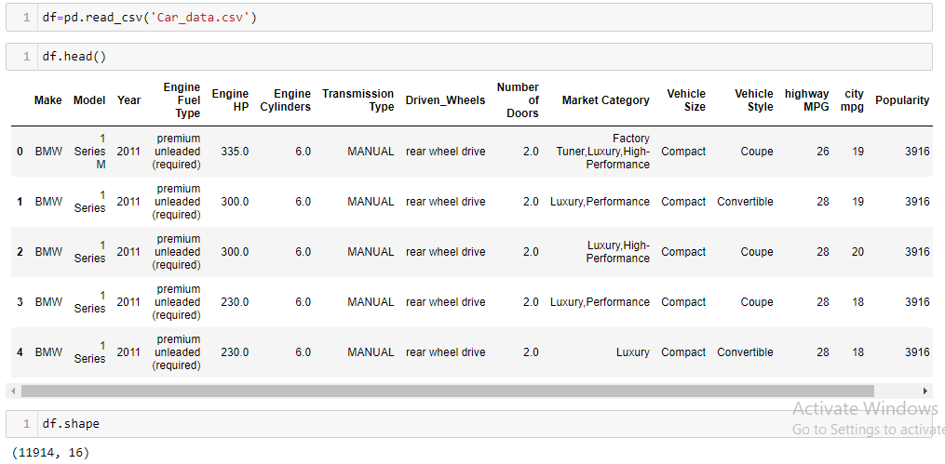
Dataset Information
The Dataset named Car_data.csv has 11914 rows (datapoints) and 16 columns (features).

Slide 6
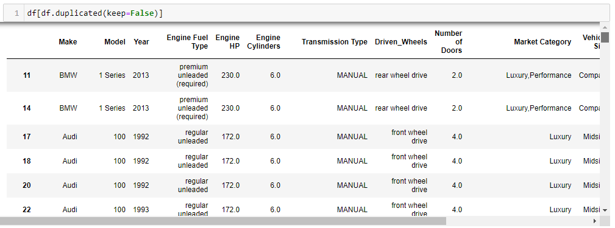

Data Pre-Processing
1. Checking for duplicates of entire row
Action:
Keeping one, dropped rest of the duplicates.

Slide 7
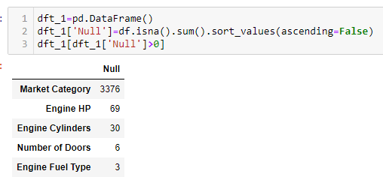
Data Pre-Processing
2. Checking for null values column wise

Slide 8
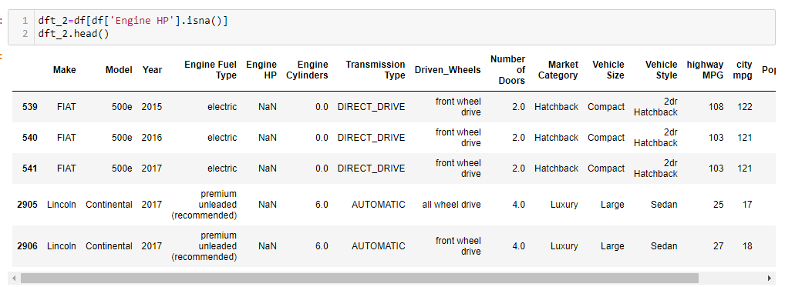
Data Pre-Processing
3 a. Dealing with Null values in Engine HP column

Slide 9
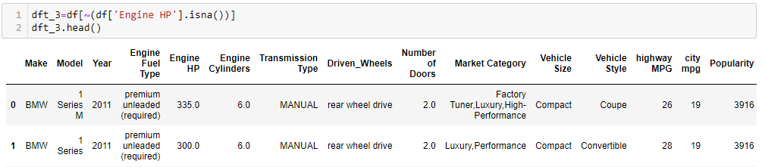
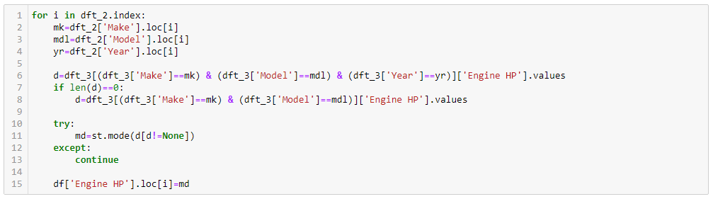
Data Pre-Processing
Action:
Getting value of Engine HP by searching for rows with same Make, Model and Year. If found then replaced null value with the mode of Engine HP value of all the matching rows.

Slide 10
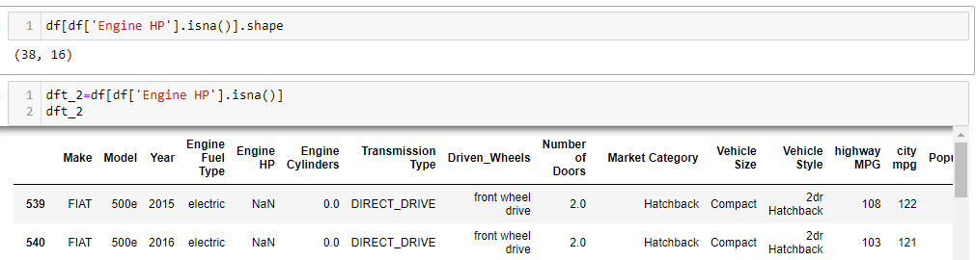
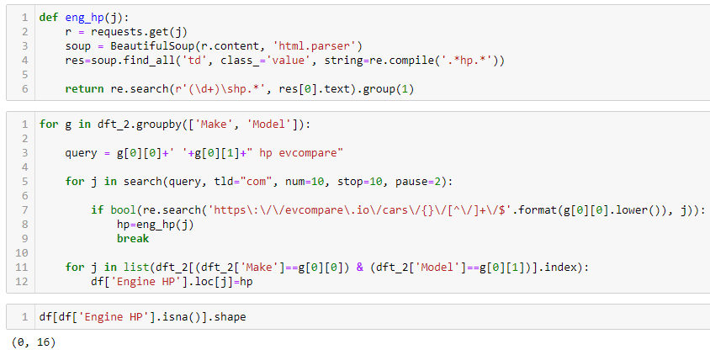
Data Pre-Processing
3 b. Dealing with Null values in Engine HP column which were not affected by the previous process
Action:
We found that all the rows which were unaffected by above process were Electric Cars. So searched for the Car model’s Engine HP (Motor’s Power) in the website evcompare.io and replaced null values with its correct values.

Slide 11
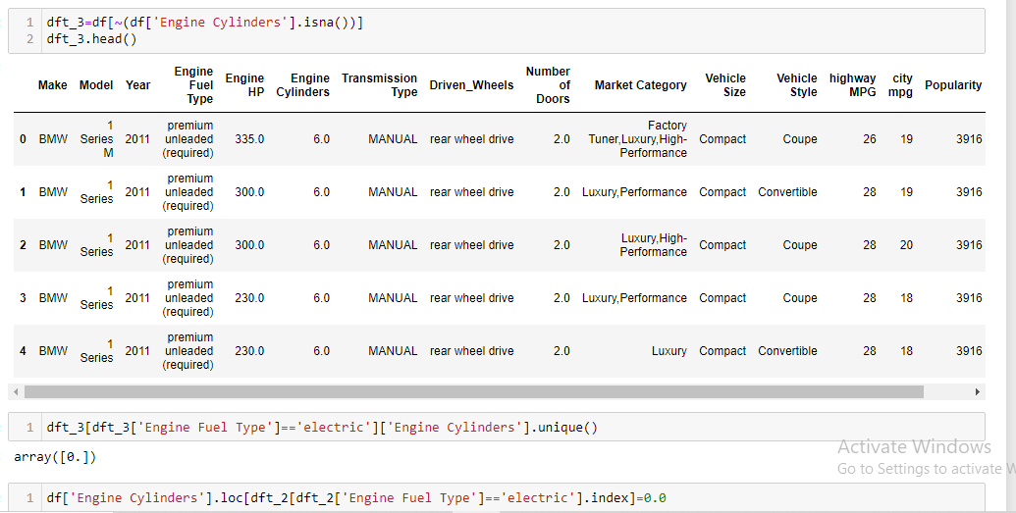
Data Pre-Processing
4 a. Dealing with Null values in Engine Cylinders column where Engine Fuel Type is electric.
Action:
We found that electric Cars have 0 Engine Cylinders which is logical. So replaced null Engine Cylinders row values whose Engine Fuel Type is electric with 0

Slide 12
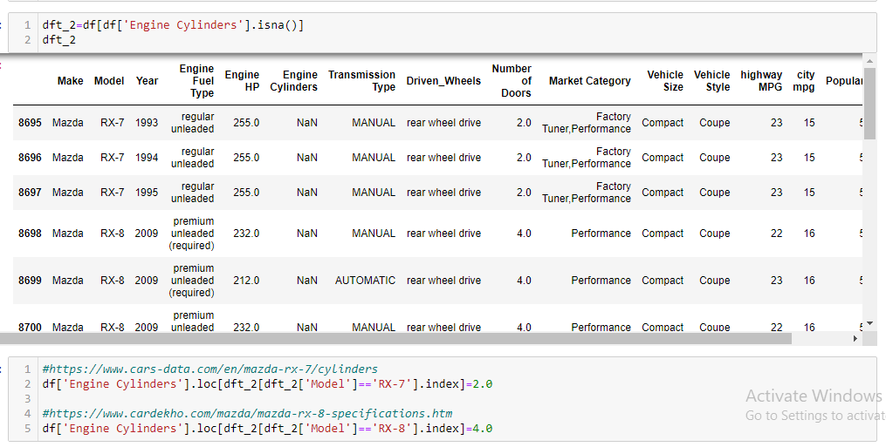
Data Pre-Processing
4 b. Dealing with Null values in Engine Cylinders column where Engine Fuel Type is other than electric.
Action:
Only two Car models had null values of Engine Cylinders. So searched for the information online and replaced them with the correct values.

Slide 13
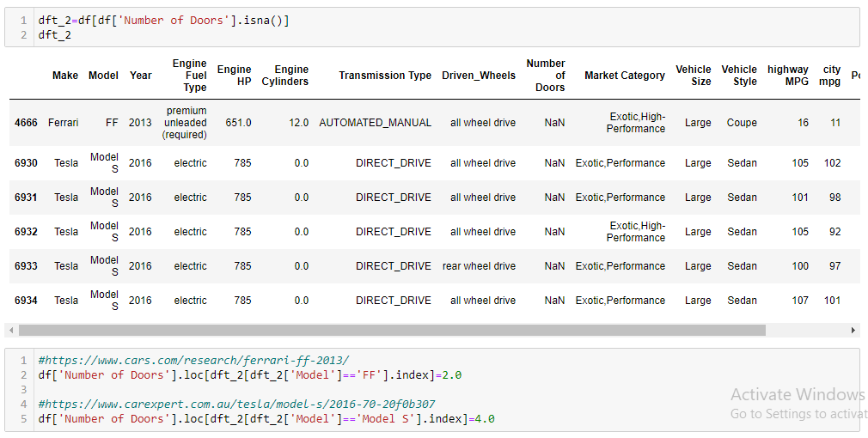
Data Pre-Processing
5. Dealing with Null values in Number of Doors column.
Action:
Only two Car models had null values of Number of Doors. So searched for the information online and replaced them with the correct values.

Slide 14
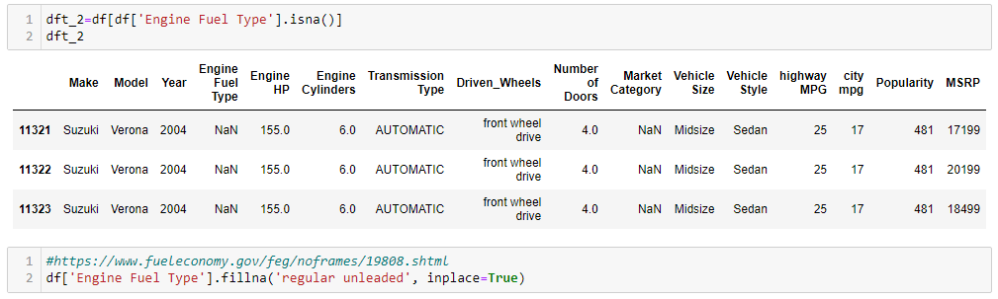
Data Pre-Processing
6. Dealing with Null values in Engine Fuel Type column.
Action:
Only one Car model had null values of Engine Fuel Type. So searched for the information online and replaced them with the correct values.

Slide 15
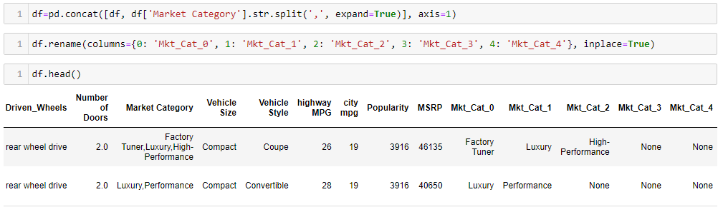
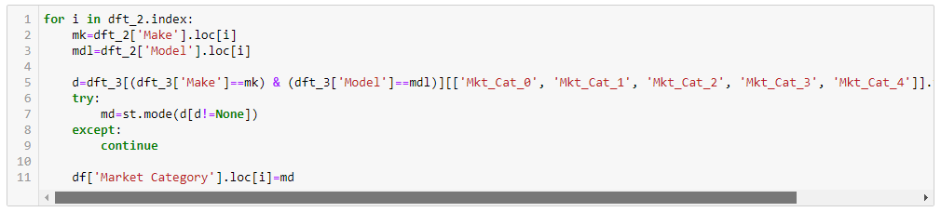
Data Pre-Processing
7 a. Dealing with Null values in Market Category column.
Action:
Separated the Categories into different columns.
Searched for Market Categories of all rows of same Car Make and Model in non null values dataframe.
Found mode of the Market Categories and replaced null value with the mode.

Slide 16
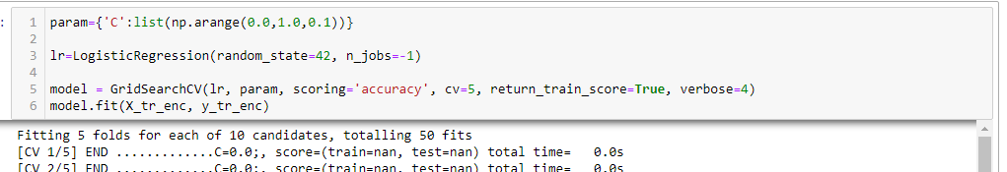
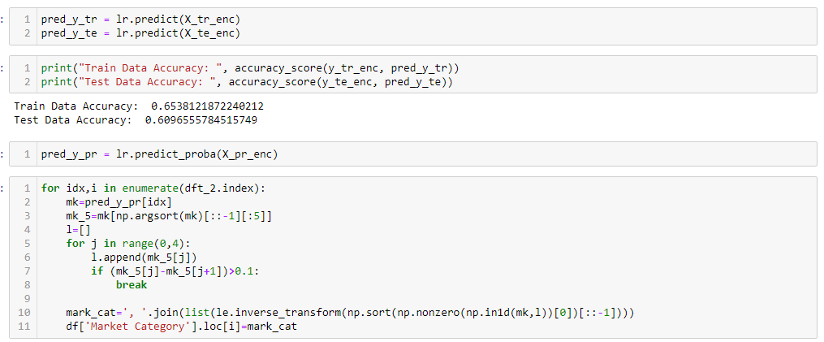
Data Pre-Processing
7 b. Dealing with Null values in Market Category column which were not affected by the previous process
Action:
Performed Multinomial Logistic Regression to get the top 4 Market Categories for the rows with null values of Market Category.

Slide 17
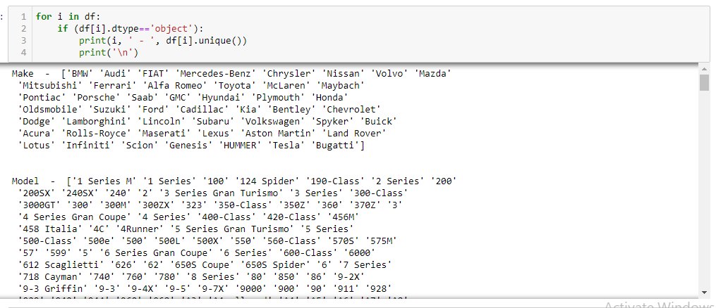
Data Pre-Processing
8 a. Checking of errors in Categorical columns.

Slide 18
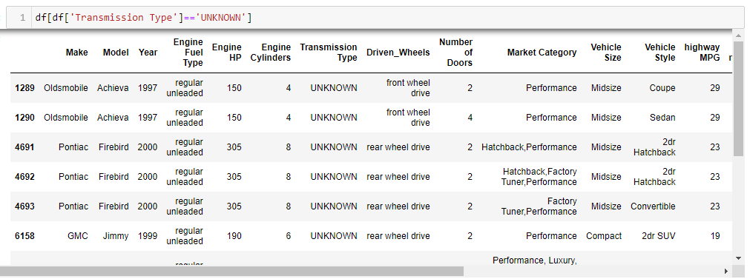
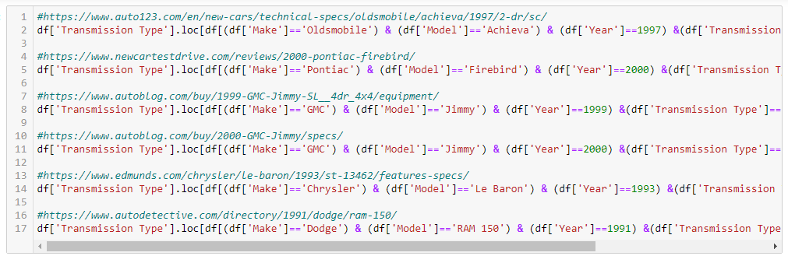
Data Pre-Processing
8 b. Dealing with errors in Transmission Type column.
Action:
Searched for the information online and replaced the value ‘UNKNOWN’ with correct ones.

Slide 19
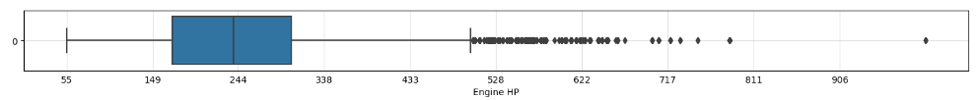
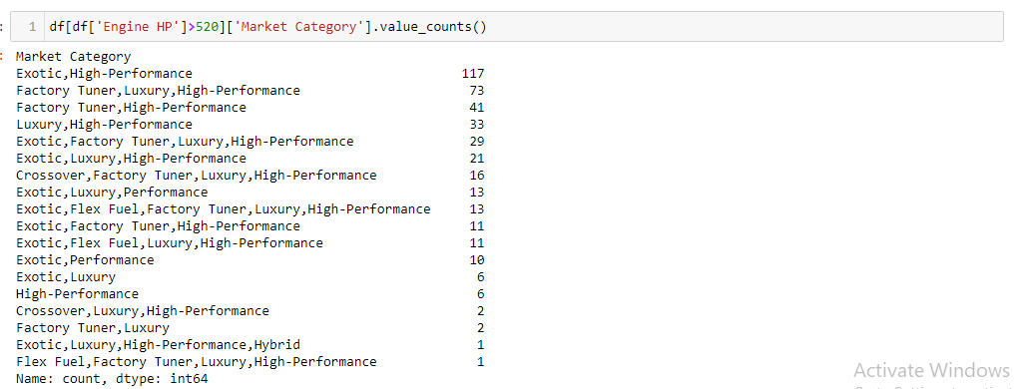
Data Pre-Processing
9. Dealing with Outliers in Engine HP column.
Action:
We checked Market Category column for all rows with Null values of Engine HP. All cars are either Exotic or High-Performance or Luxury vechiles. So didn’t change anything.

Slide 20

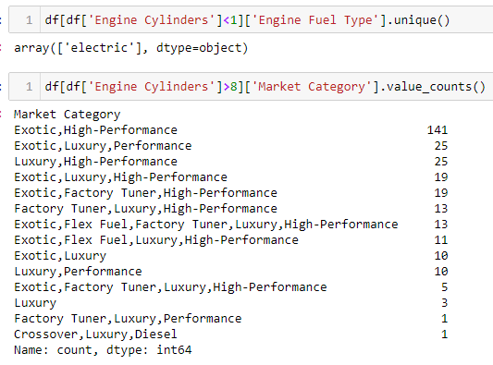
Data Pre-Processing
10. Dealing with Outliers in Engine Cylinders column.
Action:
We checked Engine Fuel Type for rows with 0 Engine Cylinders which are all are electric which is logical. For Engine Cylinders greater than 8, we checked the Market Category and all cars were either Exotic or High-Performance or Luxury. So didn’t change anything.

Slide 21
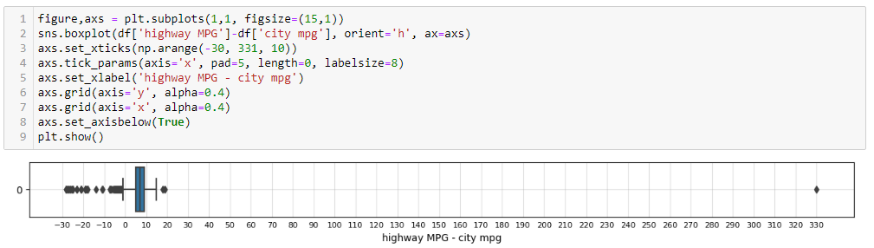
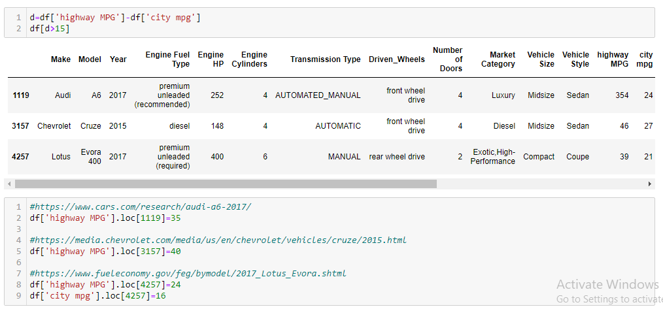
Data Pre-Processing
11. Dealing with Outliers in highway MPG and city mpg column.
Action:
We can observe that there are few negative value of differences. Generally Mileage in Highway is more than that of City. So we replaced the highway MPG of such rows with the corresponding city mpg.
Action:
Also, there are few rows where highway MPG is a lot more than city mpg. On further investigation, we found that these are not correct values. So we searched online for the correct Highway and City mileages and replaced them with the correct values.

Slide 22
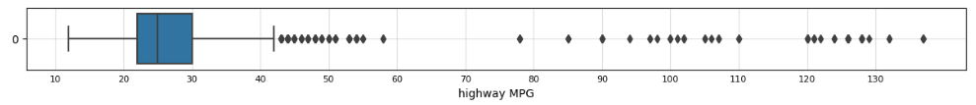
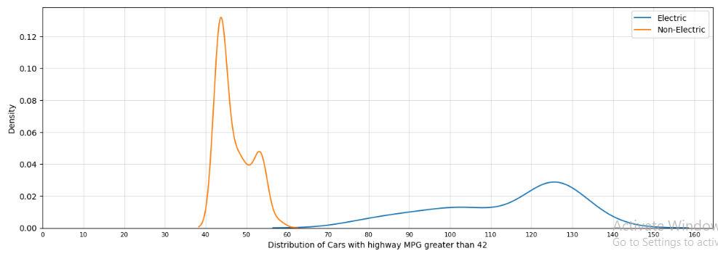
Data Pre-Processing
12. Dealing with Outliers in highway MPG column.
Action:
Considering 42 as the threshold, we can observe that a large percentage of vehicles with very high mileage are electric vehicles which is very logical. So didn’t change anything.

Slide 23
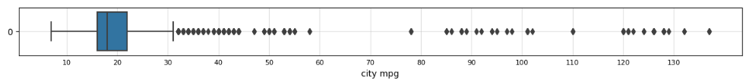
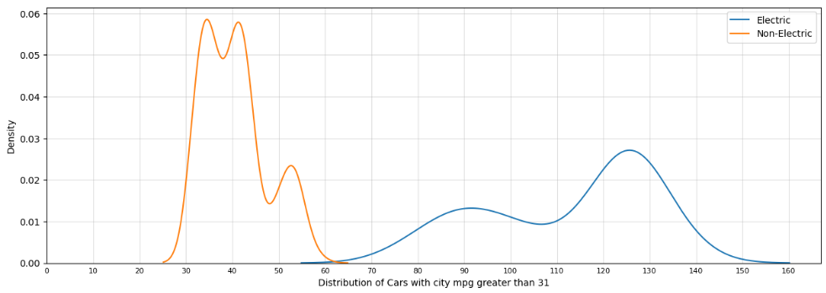
Data Pre-Processing
13. Dealing with Outliers in city mpg column.
Action:
Considering 31 as the threshold, we can observe that a large percentage of vehicles with very high mileage are electric vehicles which is very logical. So didn’t change anything.

Slide 24
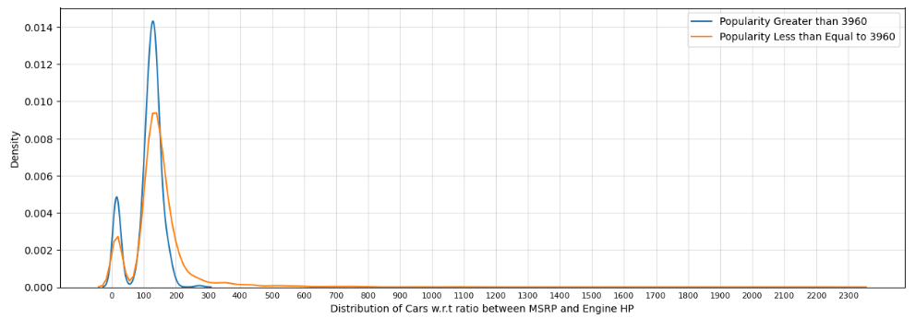
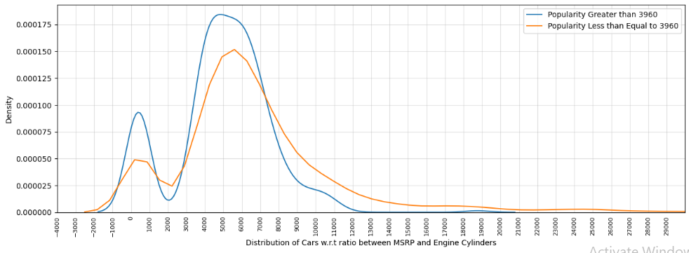
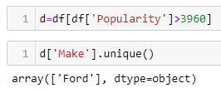
Data Pre-Processing
14. Dealing with Outliers in Popularity column.
Action:
Considering 3960 as the threshold, we can observe that the distribution of ratio of MSRP (Car Price) and Engine HP for cars whose popularity is above and below 3960 is almost the same.
Also with 3960 as threshold value, we can observe that the distribution of MSRP (Car Price) and Engine Cylinders for cars whose popularity is above and below 3960 is almost the same.
Also the cars whose popularity is above 3960 are all from Ford which implies that Ford cars are very popular in the region. So didn’t change anything.

Slide 25
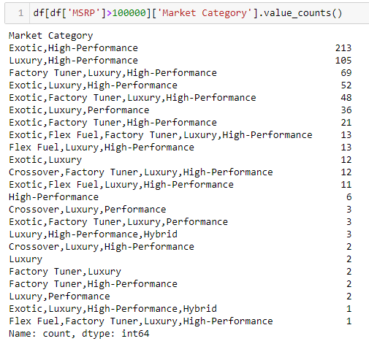
Data Pre-Processing
15. Dealing with Outliers in MSRP column.
Action:
Considering 100000 as the threshold, we can observe that the cars with price above 100000 are all Exotic or Performance or Luxury cars. So didn’t change anything.

Slide 26
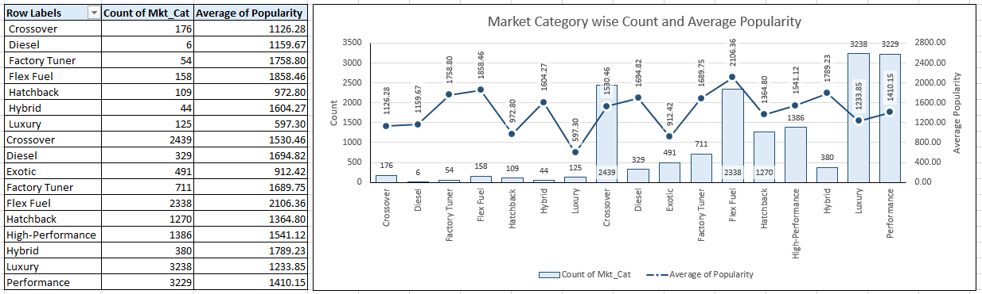
Analysis
Task 1.A: Create a pivot table that shows the number of car models in each market category and their corresponding popularity scores.
Task 1.B: Create a combo chart that visualizes the relationship between market category and popularity.
We can observe that the average popularity of cars based on their Market Category is almost the same with the exception of Luxury cars being the lowest popular and Flex Fuel cars being the most popular.
The dataset has comparatively higher number of Performance and Luxury cars followed by Crossovers and Flex Fuel cars.

Slide 27
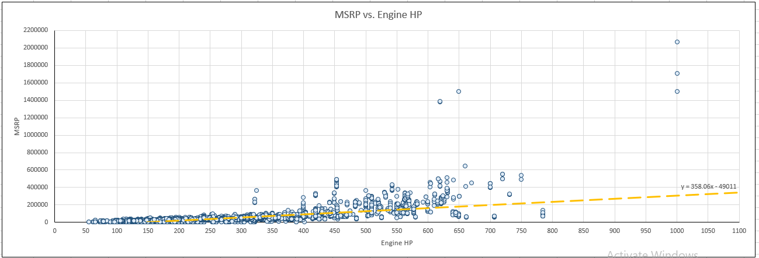
Analysis
Task 2: Create a scatter chart that plots engine power on the x-axis and price on the y-axis. Add a trendline to the chart to visualize the relationship between these variables.
We can observe that the relationship is positive as the trendline has positive slope. This is logical as higher Engine HP requires more complex level of design and engineering and more expensive sub-parts. Also cars with higher Engine HP are mostly Performance cars.

Slide 28
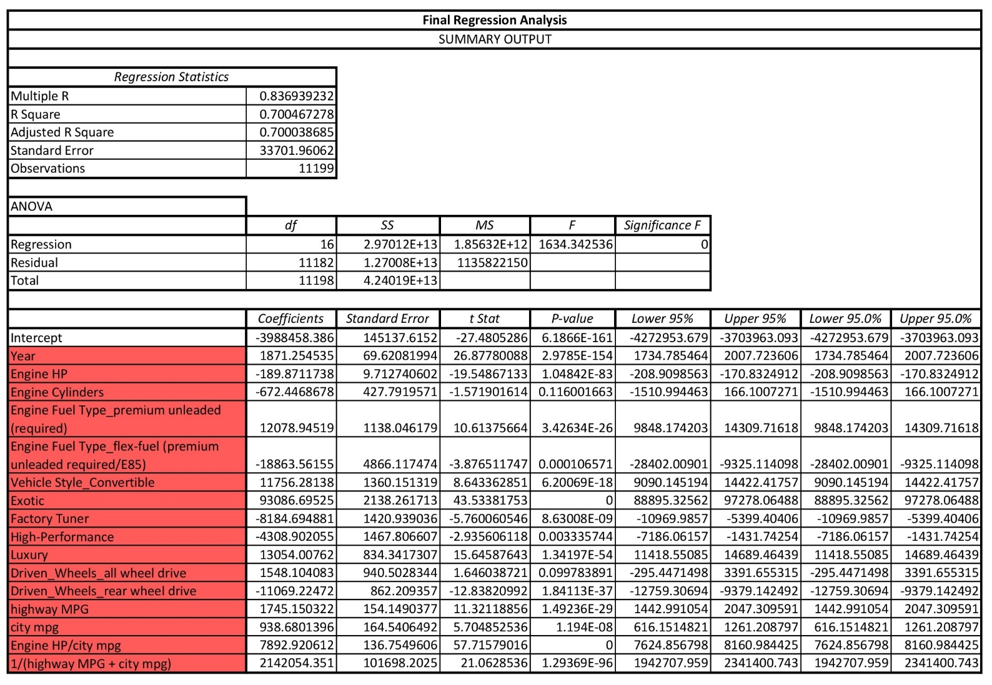
Analysis
Task 3: Use regression analysis to identify the variables that have the strongest relationship with a car's price. Then create a bar chart that shows the coefficient values for each variable to visualize their relative importance.
Using regression analysis, we found the top columns. This also include two new columns which were Feature Engineered (Engine HP/city mpg) and (1/(highway MPG + city mpg)).
We can observe that the R-Squared score is 0.7 which can be counted as a good score.

Slide 29
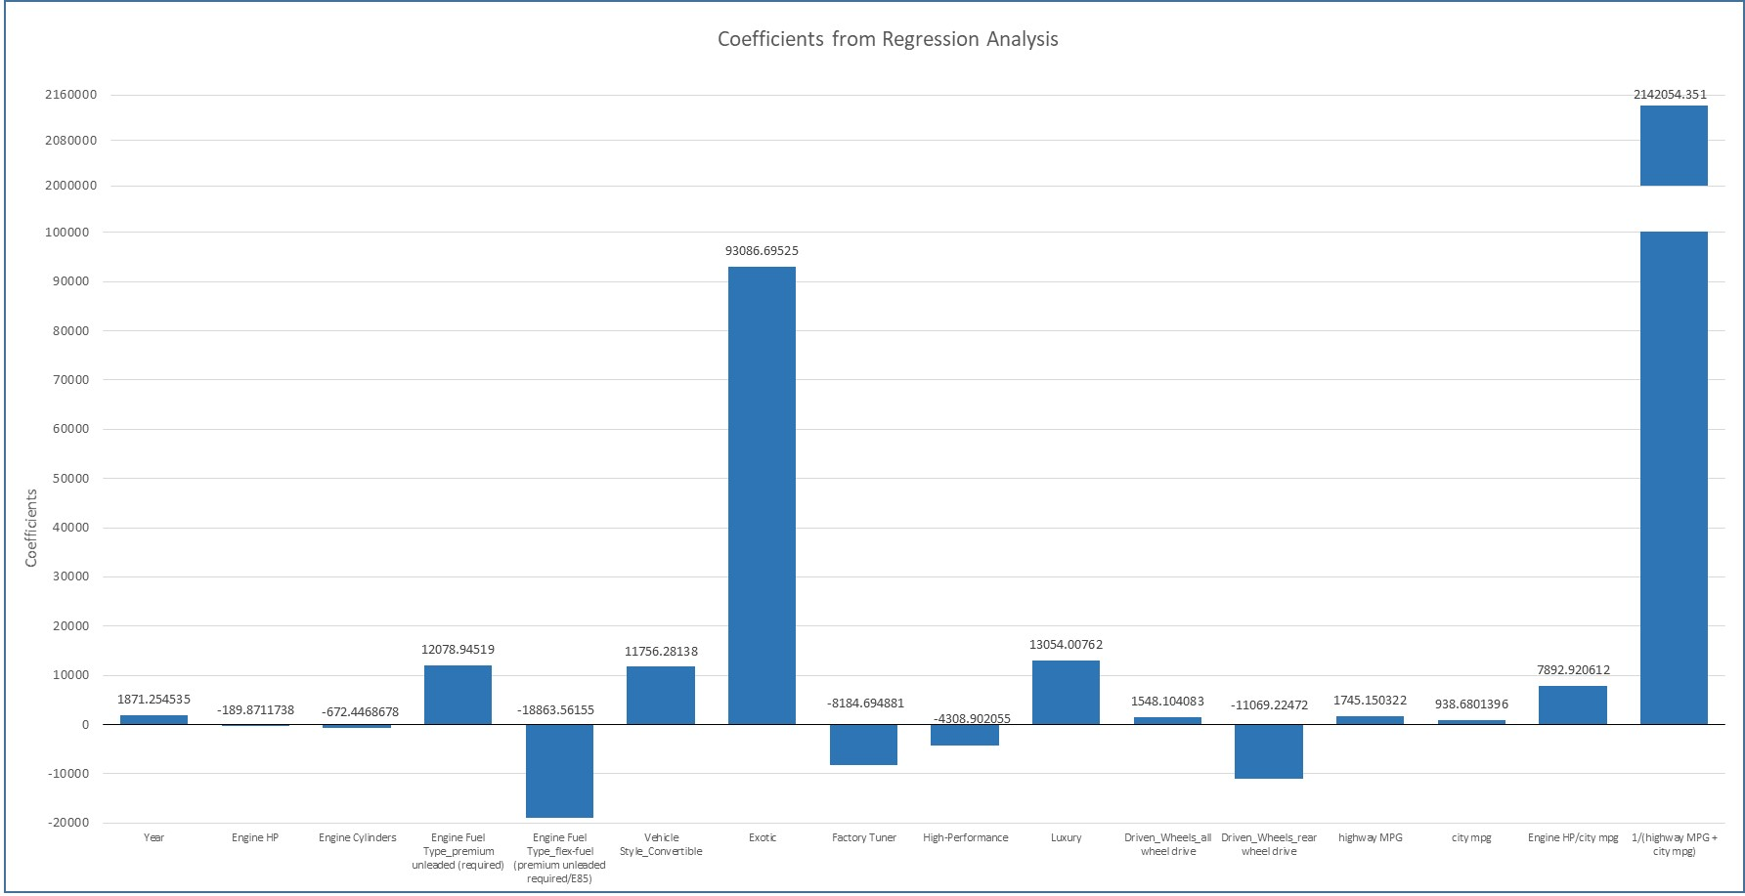
Analysis
Task 3: Use regression analysis to identify the variables that have the strongest relationship with a car's price. Then create a bar chart that shows the coefficient values for each variable to visualize their relative importance.
We can observe that the highest coefficient value is that of Engineered Feature, 1/(highway MPG + city mpg).
This shows that the Engineered Feature is very important relationship with Car’s price.

Slide 30
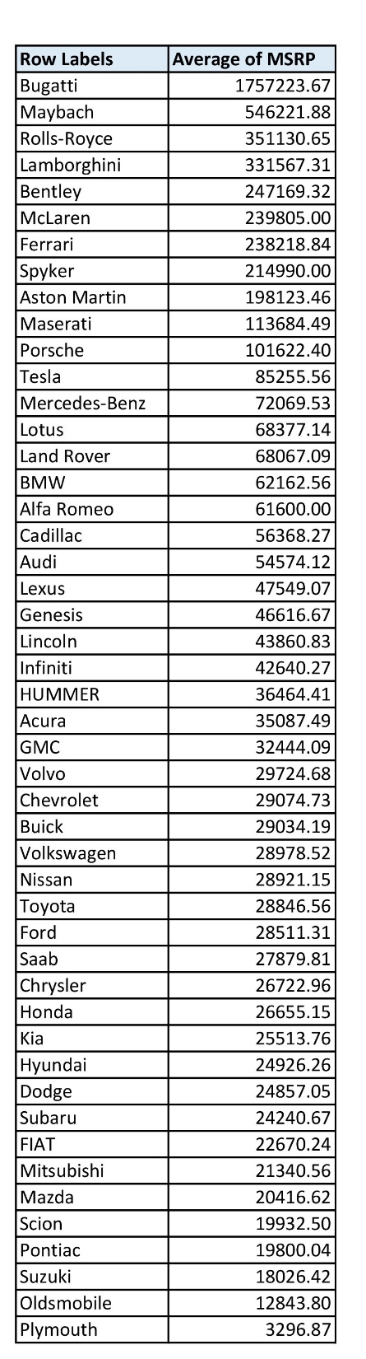
Analysis
Task 4.A: Create a pivot table that shows the average price of cars for each manufacturer.
Task 4.B: Create a bar chart or a horizontal stacked bar chart that visualizes the relationship between manufacturer and average price.
We can observe that the most expensive cars are that of Bugatti brand followed by Maybach, Rolls-Royce, Lamborghini etc. All these cars brands are High-Performance and Luxury brands.

Slide 31

Analysis
Task 5.A: Create a scatter plot with the number of cylinders on the x-axis and highway MPG on the y-axis. Then create a trendline on the scatter plot to visually estimate the slope of the relationship and assess its significance.
Task 5.B: Calculate the correlation coefficient between the number of cylinders and highway MPG to quantify the strength and direction of the relationship.
We can observe that the plot between highway MPG and Engine Cylinders has a negative slope with a value of -3.2224.
The correlation coefficient is also Negative with a value of -0.62294.
This is logical because as number of Engine Cylinders increases, the amount of fuel to be burnt also increasing, thus decreasing the mileage (highway MPG)

Slide 32
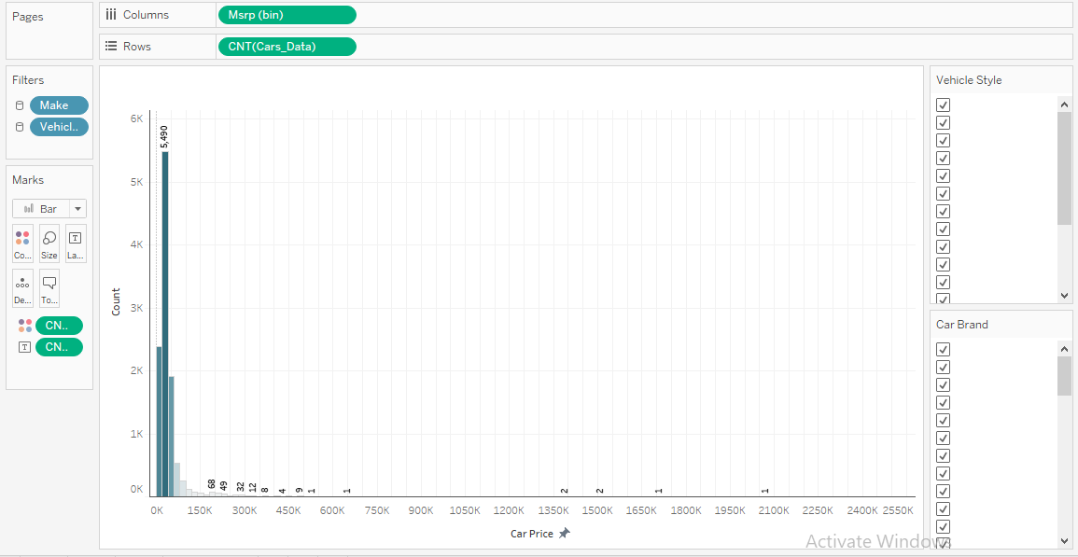
Dashboard
Task 1: How does the distribution of car prices vary by brand and body style?

Slide 33
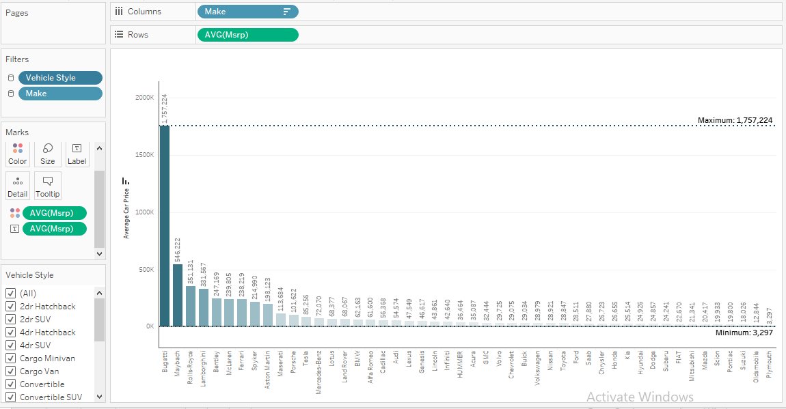
Dashboard
Task 2: Which car brands have the highest and lowest average MSRPs, and how does this vary by body style?

Slide 34
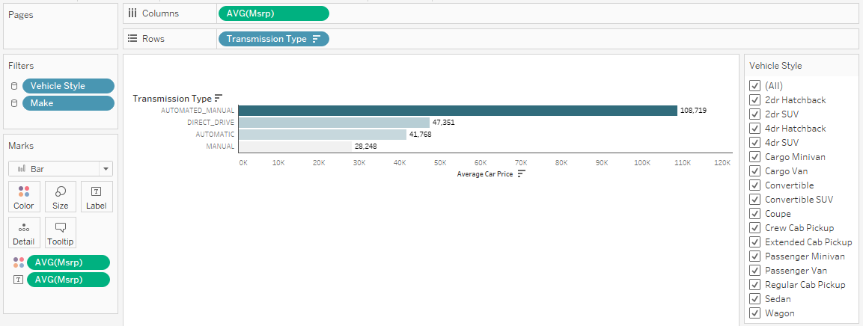
Dashboard
Task 3: How do the different feature such as transmission type affect the MSRP, and how does this vary by body style?

Slide 35
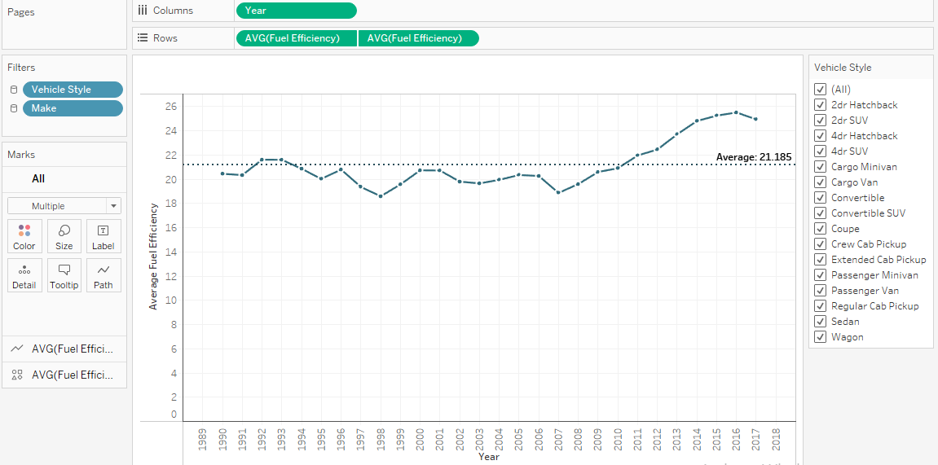
Dashboard
Task 4: How does the fuel efficiency of cars vary across different body styles and model years?

Slide 36
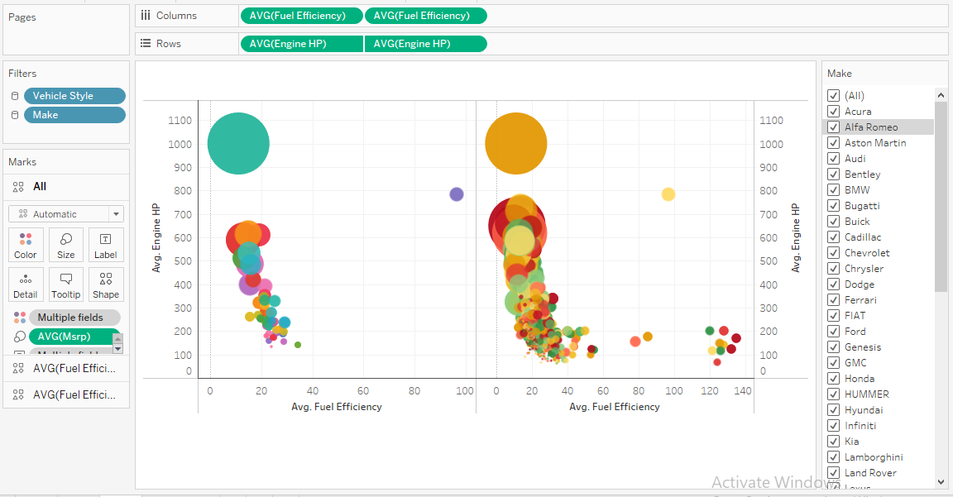
Dashboard
Task 5: How does the car's horsepower, MPG, and price vary across different Brands?

Slide 37
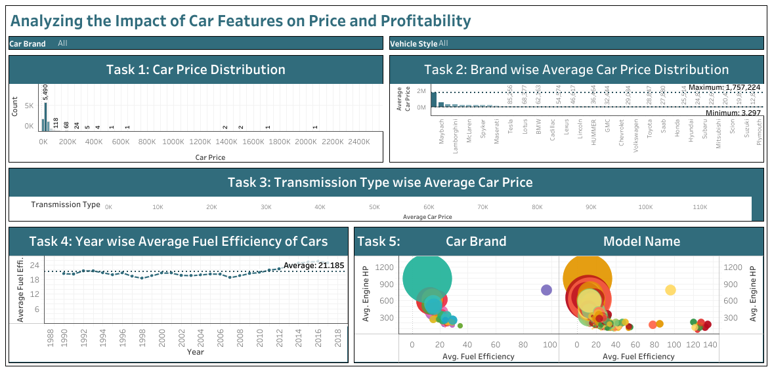
Dashboard
Complete Dashboard
Tableau Link
https://public.tableau.com/views/Project7_16955900575650/Dashboard1?:language=en-US&:display_count=n&:origin=viz_share_link

Slide 38

Result
Through this project, I was able to understand the importance of Data Analytics in Car Feature Analysis as it provides valuable insights which helps in making Data-Driven Decisions.
In this project I was able to get insights like which features effects Car Price, relationship between Engine Cylinders and it’s fuel efficiency etc. I also got experience in Data Preprocessing like Data Cleaning, handling Outliers, Feature Engineering etc. in this project. I can communicate the insights to relevant stakeholders as per the requirements using which they can make proper data-driven decisions.
This Project has also helped me in understanding the various functions of Python, Excel and Tableau and its working.
Image Source: Google Images

Slide 39
Thank You
Contact: avi22nayak@gmail.com

